Slide 1


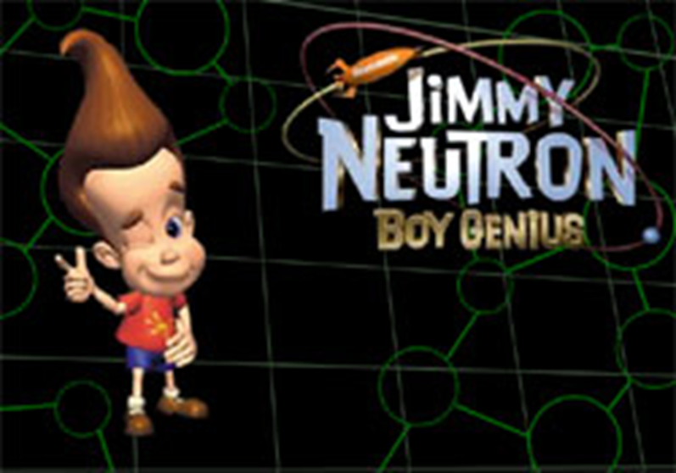
Interactions of Radiation with Matter:
Neutrons

Slide 2
Neutron Applications
Shielding calculations
Neutron scattering; crystal studies, DNA
Neutron activation analysis
Neutron radiography; paintings, water uptake in plants
Weapons research
Nuclear structure- fundamental physics
Reactor Physics
Neutron dosimetry for medical physics

Slide 3
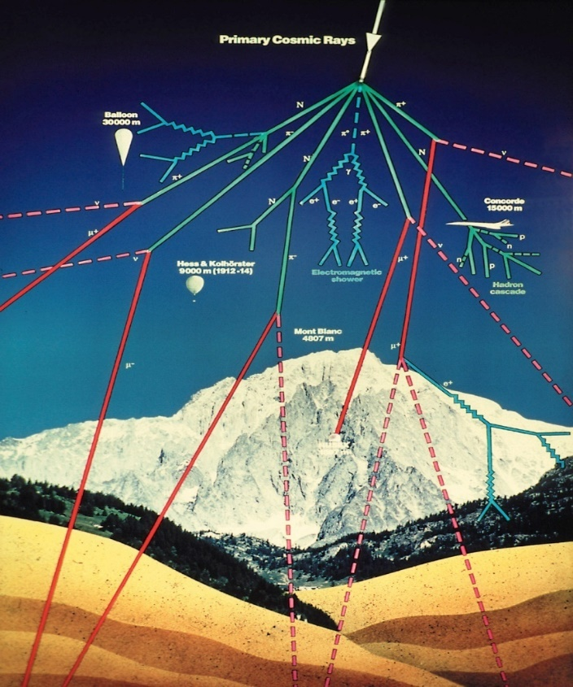
Sources of Neutrons
Primary cosmic rays are particles such as protons and neutrons moving at high energies through the interstellar medium.
Locally, many of these are ejected from the sun.
When these primary cosmic rays come toward earth, they encounter atmospheric nuclei at around 30,000 m above the surface.
The impacts cause nuclear reactions which produce pions.
The pions decay into muons; this generally occurs at around 9000 m altitude.
http://www.jlab.org/~cecire/muonexp.html

Slide 4
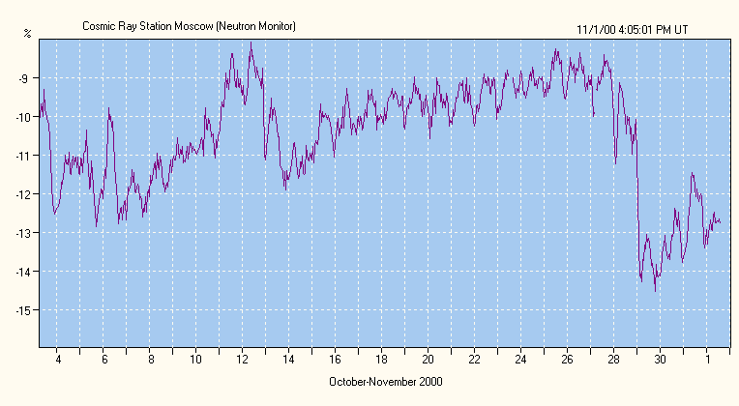
Sources of Neutrons cont’d

Slide 5
Sources of Neutrons cont’d
Nuclear reactor most prolific source
Energy spectrum from the fission of ²³⁵U extends from several keV to more than 10 MeV
Most probable energy ~ 0.7 MeV
Average energy ~ 2 MeV
There are no naturally occurring radioisotopes which emit neutrons

Slide 6
Sources of Neutrons cont’d
One can manufacture a radioactive neutron source by combining an alpha emitting radionuclide such as ²¹⁰Po, ²²⁶Ra or ²³⁹Pu with a light metal such as Be or B
The reactions that follow are:
⁹Be(α, n)¹²C
¹⁰B(α, n)¹³N
¹¹B(α, n)¹⁴N
There is a continuous energy spectrum

Slide 7
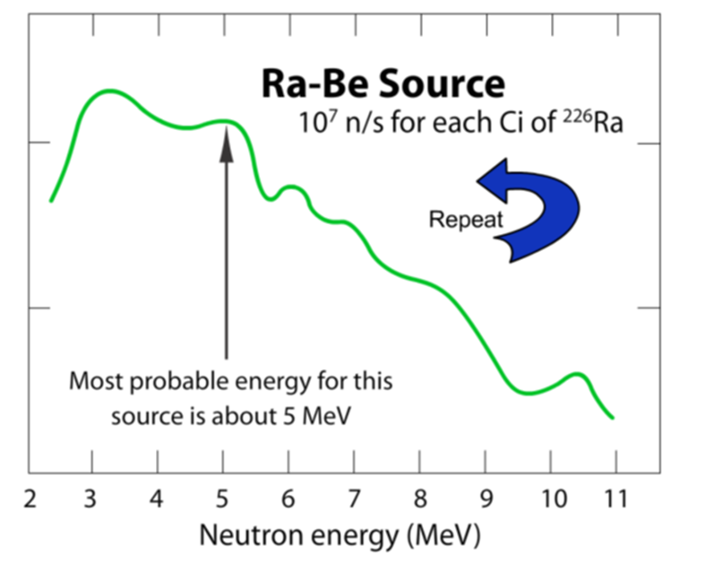
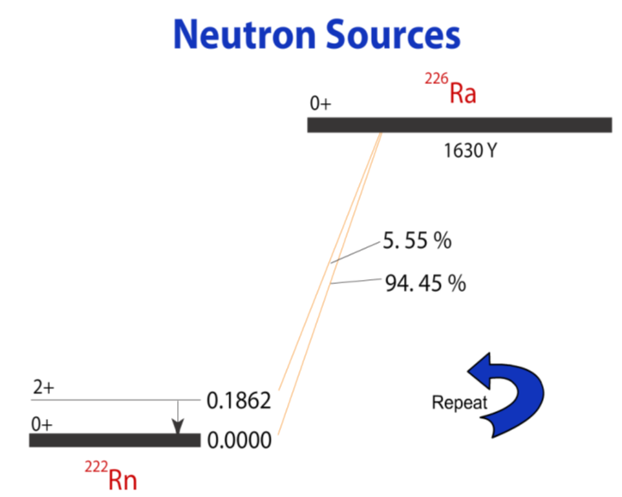

Slide 8
Sources of Neutrons (α,n)

Slide 9
Sources of Neutrons cont’d
Photoneutron sources using (γ,n) reactions
By choosing radioisotopes with a single γ-ray then monoenergetic neutrons can be produced
The sources are produced in an electron accelerator where electrons impinge on a target
γ 's then interact as follows:
⁹Be(γ,n)⁸Be
²H(γ,n)¹H

Slide 10
Sources of Neutrons cont’d
Accelerator Neutrons
Particle accelerators are used to generate neutrons by means of nuclear reactions such as: D-T, D-N, P-N
³H(d,t)⁴He Q-value = 17.6 MeV →14.1MeV neutrons
²H(d,n)³He Q-value = 3.27 MeV
⁷Li(p,n)⁷Be Q-value = 1.65 MeV
Positive Q-values means the nuclear reaction can be induced with only several hundred keV ions

Slide 11
Sources of Neutrons cont’d
Some heavy nuclei fission spontaneously emitting neutrons
Some sources include: ²⁵⁴Cf, ²⁵²Cf, ²⁴⁴Cm, ²⁴²Cm, ²³⁸Pu and ²³²U
In most cases the half-life for spontaneous fission is greater than alpha decay
²⁵⁴Cf decays almost completely by spontaneous fission with a
60-day half-life

Slide 12

Neutrons from Spontaneous Nuclear Decay

Slide 13
Neutrons from Spontaneous Nuclear Decay
²⁵²Cf undergoes spontaneous nuclear fission at an average rate of 10 fissions for every 313 alpha transformations
Half-life of ²⁵²Cf due to alpha emission is 2.73 years
with spontaneous nuclear fission its effective half-life is 2.65 years
Neutron emission rate is 2.31 × 10⁶ neutrons per second per microgram of ²⁵²Cf
Emitted neutrons have a wide range of energies with the most probable at ~ 1 MeV and the average value ~ 2.3 MeV

Slide 14
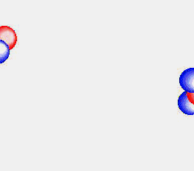
Neutrons are also produced through fusion
The deuterium-tritium (D,T) reaction produces a 14 MeV neutron.
The deuterium-deuterium (D,D) produces a 2 MeV neutron.

Slide 15
Classification of Neutrons
Neutrons are classified according to their energy
Thermal neutrons have an energy of about ~ 0.025 eV
Epithermal neutrons, resonance neutrons, slow neutrons have energies between 0.01 MeV and 0.1 MeV
Fast neutrons - 0.1 MeV and 20 MeV
Relativistic neutrons

Slide 16
Neutron Energy Ranges

Slide 17
Classification of Neutrons cont’d
At thermal energies neutrons are indistinguishable from gas molecules at the same temperature and follow the Maxwell-Boltzman distribution:
where:
ƒ (E) = fraction of neutrons of energy
e/unit energy interval
k = Boltzman constant × 10⁻²³ J/ºK
T = absolute temperature ºK

Slide 18
Classification of Neutrons cont’d
Most probable energy is:
E_{mp} = kT
Average energy at any given temperature is:
For neutrons at 293 ⁰K most probable energy is 0.025 eV

Slide 19
Classification of Neutrons cont’d
Velocity:
Neutron half-life is 10.6 minutes
Cold neutrons are much slower

Slide 20
Neutron Interactions
The neutron has a mass of 1 and no charge.
Since it has no charge, it can penetrate a nucleus fairly easily.
Bound neutrons are stable; unbound neutrons are unstable and have a t_{1/2} ≈ 10.6 minutes.
Free neutrons interact with the nuclei in the material they are in and lose energy.
Interactions with the nucleus are very energy dependent so neutrons are classified on the basis of their kinetic energies.

Slide 21
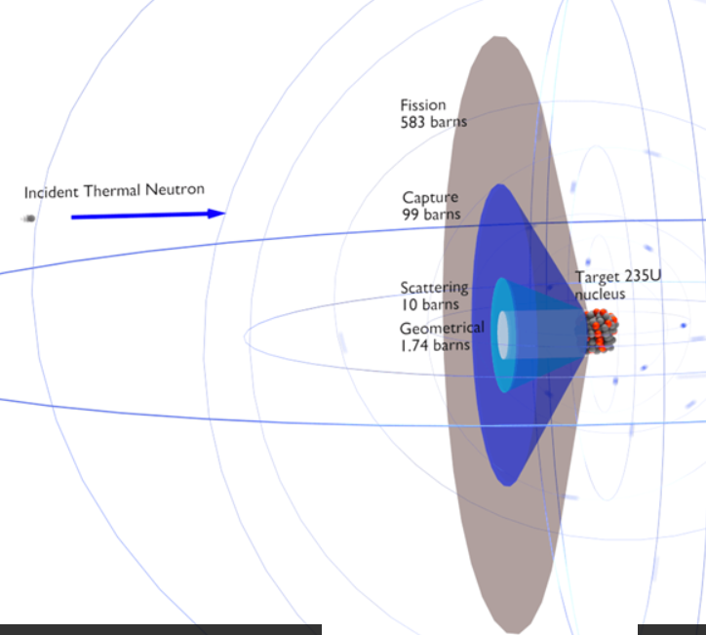
Neutron Interactions cont’d
Neutrons essentially interact only with the atomic nucleus
Cross-sections can vary dramatically and erratically based on complex interactions between all the nucleons in the nucleus and the incident neutron
Huge effort has been spent to measure these cross-sections for many materials and a wide range of neutron energies

Slide 22
Neutron Interactions cont’d
Elastic Scattering
Inelastic Scattering
Radiative Capture
n
n
n
γ
n
n
γ
Charged-Particle
Reactions
[(n,a), (n,p), (n,d), etc.]
Neutron-Producing
Reactions
[(n,2n), (n,3n), etc.]
Fission
n
n
n
n
n
n
n
n
α

Slide 23
Elastic Scattering
Elastic scattering is an interaction with the nucleus – it is when the original free neutron continues to be a free neutron following the interaction.
Scattering is the dominant process for fast neutrons when the neutron is moving too fast to become a part of a nucleus.
Multiple scattering by a neutron is the mechanism of slowing down or "moderating" fast neutrons to thermal energies. This process is sometimes called "thermalizing" fast neutrons.

Slide 24
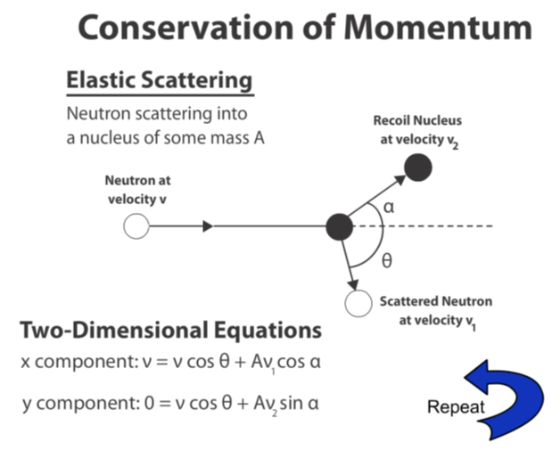

Slide 25
Elastic Scattering
Elastic scattering occurs when a neutron strikes a nucleus (about the same mass as that of the neutron)
Depending on the size of the nucleus, the neutron can transfer much of its KE to that nucleus which recoils off with the energy lost by the neutron.
H causes the greatest energy loss to the neutron because the single proton in the nucleus is the same mass as the neutron.
No gamma radiation is given off by the nucleus. The recoil nucleus can be knocked away from its electrons and, being positively charged, can cause ionization and excitation.

Slide 26
Elastic Scattering cont’d
Using conservation laws, the energy E of a scattered neutron after a head-on collision is:
E_{o} = energy of incident neutron
m = mass of incident neutron
M = mass of scattering nucleus
Energy transferred to the target nucleus is E_{o}-E.

Slide 27
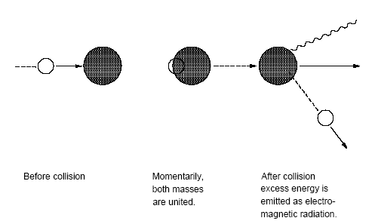
Inelastic Scattering
Inelastic scattering occurs when a neutron strikes a large nucleus. The neutron penetrates the nucleus for a short period of time, transfers energy to a nucleon inside, and then exits with a small decrease in energy.
The nucleus is left in an excited state, emitting gamma radiation which can cause ionization and/or excitation.

Slide 28
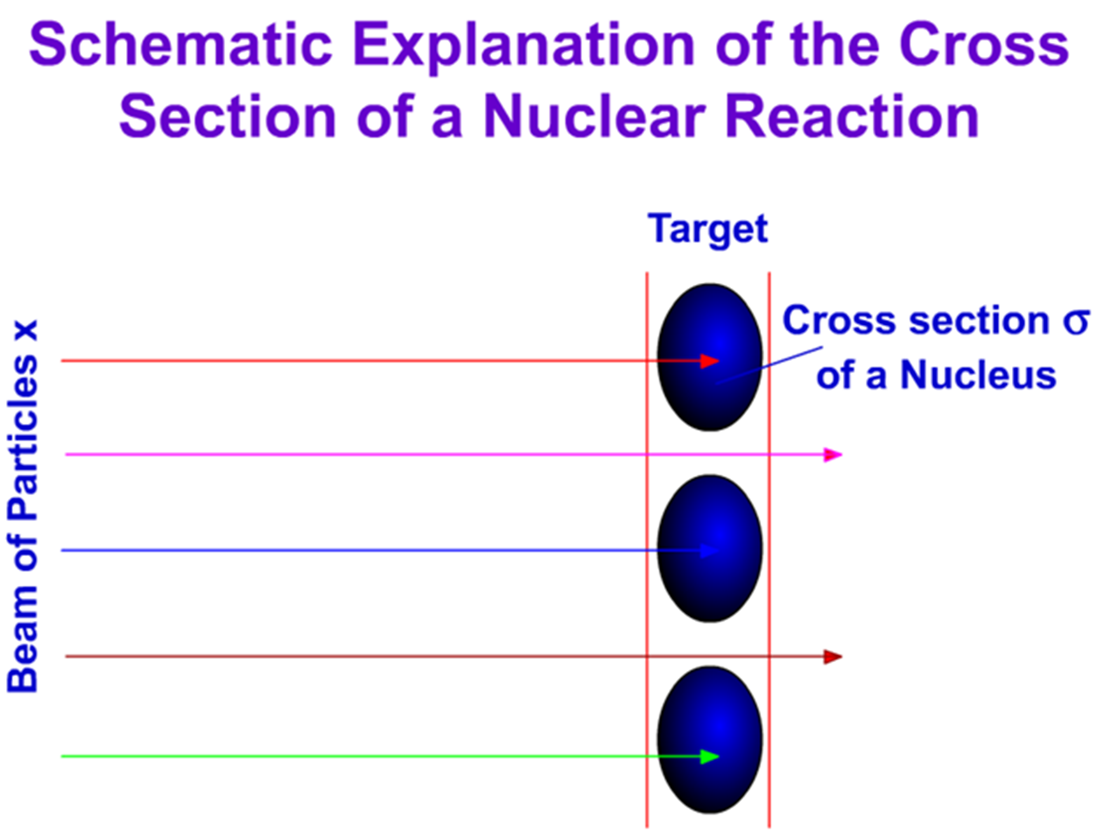

Slide 30
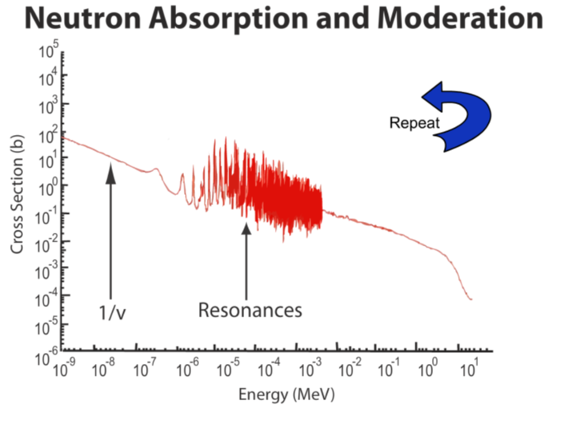

Slide 31
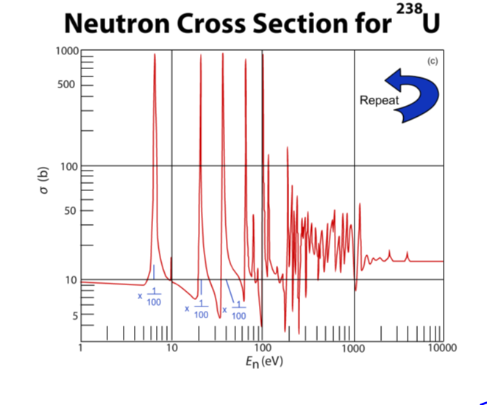

Slide 32
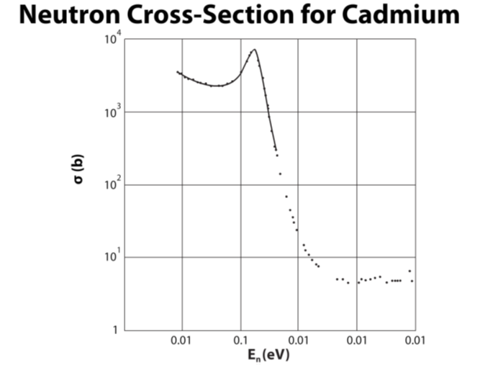

Slide 33
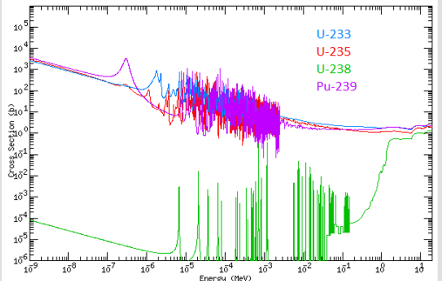
Interaction of Neutrons cont’d
Absorption/Radiative Capture (n,γ)
Capture cross-sections for low energy neutrons generally decreases as the reciprocal of the velocity as the neutron energy increases
Phenomenon called 1/v law
Valid up to 1000 eV
If the capture cross-section σ₀ is known for a given neutron velocity v₀ or energy E₀, then the cross-section at some other velocity v or energy E can be estimated:

Slide 34
Interaction of Neutrons cont’d
Problem:
the cross-section of for the ¹⁰B(n,α)⁷Li reaction is 3886 barns for thermal (0.025 eV) neutrons. What is the cross-section at 50 eV?

Slide 35
Interaction of Neutrons cont’d
As with γ's neutrons are also removed exponentially when absorbers are placed in front of them:
I= I₀e^{-σNt} where:
I₀ = initial # of number of neutrons
I = # of neutrons passed through the target
σ = microscopic cross-section
N = # of absorber atoms in atoms/cm³ in the target
t = thickness of the target
Neutron cross-section is strongly energy dependent

Slide 36
Interaction of Neutrons cont’d
problem:
A 1 cm thick lead absorber attenuated an initial 10 MeV neutron beam to 84.5% of its value
What is total cross-section given that the atomic weight of Pb = 207.21 and its density is 11.3 gm/cm³?

Slide 37
Interaction of Neutrons cont’d
= 5.1 × 10⁻²⁴ cm²
= 5.1 barns (microscopic cross-section)
● macroscopic cross-section:
∑ = σN
∑ = 5.1 × 10⁻²⁴ cm² × 3.29 × 10²² cm⁻³
∑ = 0.168 cm⁻¹

Slide 38
Neutron Activation
Production of a radioactive isotope by the absorption of a neutron, eg:
(n,γ) (n,p) (n,α) (n,n')
If N_{T} target atoms with a cross-section σcm² are being neutron irradiated with a fluence of n cm⁻² sec⁻¹ then the production rate of daughter atoms is:

Slide 39
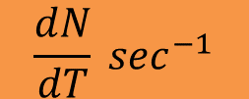
Neutron Activation cont’d
The number of daughter atoms is N having a decay constant λ
The rate of loss of daughter atoms is λN
The rate of change is
$$\frac{dN}{dT} \sec^{−1}$$
In the number of daughter atoms presented at any time while the target is bombarded is:

Slide 40
Neutron Activation cont’d
Assume the neutron fluence rate is constant and the original number of atoms is not being excessively depleted, so N_{T} is constant:
let N = a + be^{-λt} 
bλe^{-λt} = φσN_{T} -aλ -bλe^{-λt}
Both exponential terms cancel out 

Slide 41
Neutron Activation cont’d
Therefore, the original solution is:
The constant b depends on the initial conditions
at N = 0, t = 0 we get
The final expression is:

Slide 42
Neutron Activation cont’d
(
−
λ
)
λ
N
=
φσ
N
1
-
e
t
T
where:
λN - represents activity of daughter as a function of t
φσN_{t} - is called saturation activity
representing maximum activity at
time t  ∞
When neutrons are not monoenergetic as in a reactor, an average cross-section is used for σ

Slide 43
Neutron Activation cont’d
The previous equation is the activity just at the end of production
If one is interested in the activity sometime later the following terms must be added:
where:
t_{i} = irradiation time
t_{d} = decay time
t_{c} = counting time

Slide 44
Neutron Activation cont’d
problem:
A certain radioisotope is produced by neutron activation of a sample that contains 5 × 10²² target atoms with an activation cross section of 2 barns
The neutron rate, 10¹¹ cm⁻² s⁻¹, is constant
The half-life of the isotope is 8.5 hours.
a. Calculate the saturation activity in Bq

Slide 45
Neutron Activation cont’d
The induced activity A as a function of time t after starting the exposure is given by:
A= φσN_{T} (1- e^{-λt})
where:
φ = neutron fluence rate or flux density
σ = cross section
N_{T} = no. of target atoms in sample
Activity, starting with A=0 when t=0, builds up as t increases

Slide 46
Neutron Activation cont’d
When t becomes very large  exponential term in above formula becomes negligibly small; and the activity approaches its maximum, or saturation value

Slide 47
Neutron Activation cont’d
b. Calculate the activity reached after exposure for 24 h
c. What fraction of the saturation activity is reached at this time?
solution:
b. Use

Slide 48
C: What fraction of the saturation activity is reached at this time?
Decay constant is:
Therefore:
Fraction of the saturation activity is:

Slide 49
Neutron Activation cont’d
problem:
Three grams of ³²S are irradiated with fast neutrons
having a fluence rate of 155 cm⁻²sec¹ - cross-section is
0.200 barns and the half-life of ³²P is 14.3 days
a. What is the maximum ³²P activity that can be induced?
Solution:
a.

Slide 50
Neutron Activation cont’d
Since there are 3.7 × 10¹⁰ disintegrations/ second/Curie 
b. How many days are needed for the level of the activity to reach 3/4 maximum?
Solution:
b. Time t needed to reach 3/4 of the value can be calculated:

Slide 51
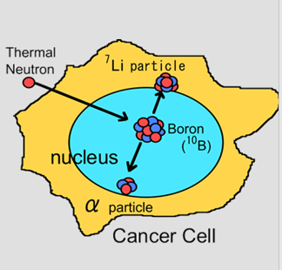
Charged Particle Emission
A second type of general reaction for slow neutrons is that giving rise to charged particle emission.
Typical examples include (n,p), (n,d), and (n,α) reactions, i.e., reactions in which a proton, a deuteron, or an alpha particle is ejected from the target nucleus.

Slide 52
Fission
A type of neutron-induced reaction is fission.
Generally, fission occurs following the absorption of a slow neutron by several of the very heavy elements.
When ²³⁵U nuclei undergo fission by neutrons, an average of 2 to 3 neutrons are emitted along with associated gamma radiation.

Slide 53
Fission
When a thermal neutron is absorbed in ²³⁵U (580 barns), ²³⁹Pu (747 barns) or ²³³U (525 barns) vibrations in these nuclei cause them to split (fission) under mutual electrostatic repulsion of its parts
In general:

Slide 54
Distribution of Energy Among Products Released by Fission of ²³⁵U
kinetic energy of charged fission fragments | 162 MeV
fission neutrons | 6
fission gamma rays | 6
subsequent beta decay | 5
subsequent gamma decay | 5
neutrinos | 11
total | 195 MeV

Slide 55
Distribution of Energy Among Products Released by Fission of ²³⁵U
The fission process is bimodal in distribution
All fission fragments are radioactive and there are several steps before stable daughters are produced
Decay of the collective fission-product activity following fission of a number of atoms is:
A ≅ 10⁻¹⁶ t^{-1.2} curies/fission
where t is in days

Slide 56
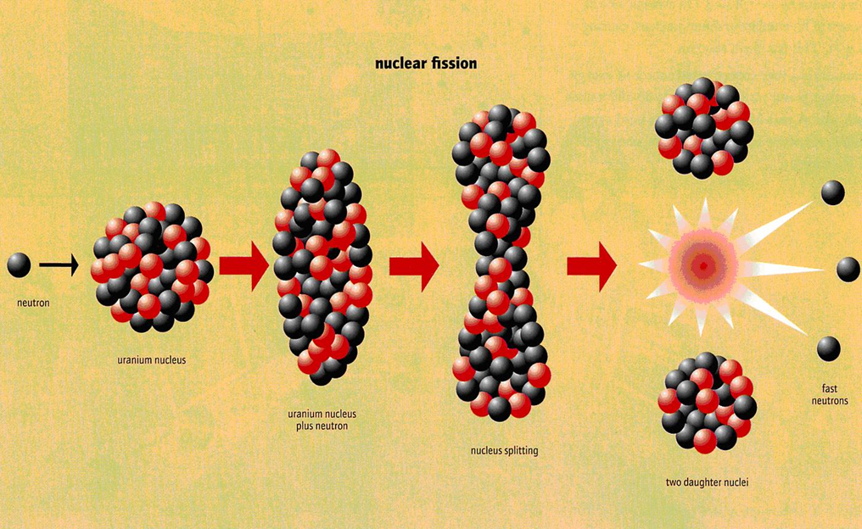
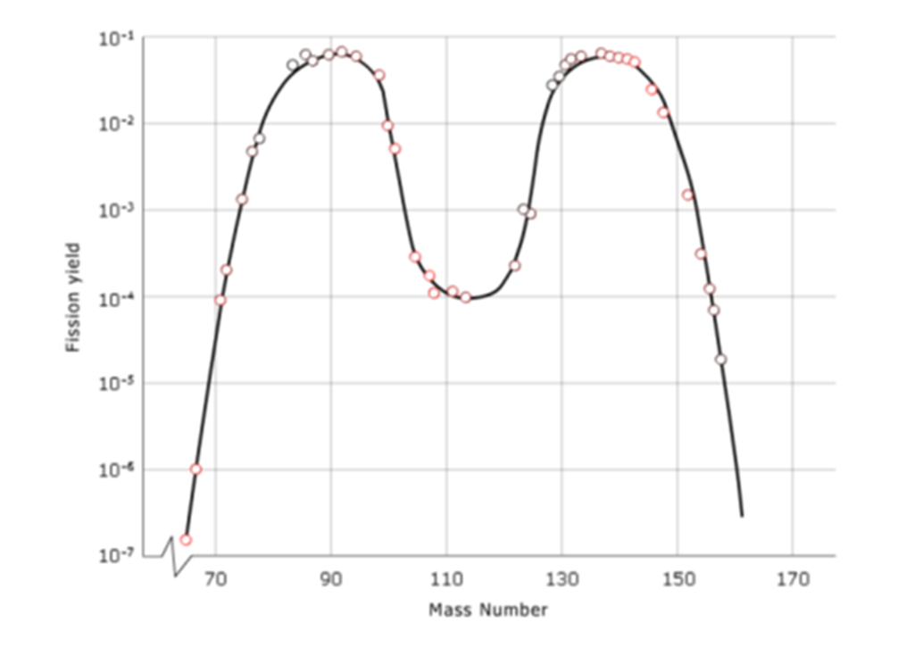
Fission cont’d
The nucleus splits into two smaller nuclei which are called primary fission products or fission fragments.
These products usually undergo radioactive decay to form secondary fission product nuclei.

Slide 57
Fission cont’d
Example: If one neutron fissions a ²³⁵U, for example it could yield ⁹⁵Y, ¹³⁹I, two neutrons, and fission energy.
There are some 30 different ways that fission may take place with the production of about 60 primary fission fragments.
These fragments and the atoms which result from their decay are referred to as fission products
Many fission products have found application in medicine, industry, and research
A well-known example is ¹³¹I which is used extensively in medicine as both a diagnostic and therapeutic agent.

Slide 58
Fission cont’d
These fragments and the atoms which result from their decay are referred to as fission products
Many fission products have found application in medicine, industry, and research
A well-known example is ¹³¹I which is used extensively in medicine as both a diagnostic and therapeutic agent.

Slide 59
